Slide 1
DATA SCIENCE HW2_脫硫預測

Slide 2
PART PRE-PROCESSING
1

Slide 3
Step 1 Import data in the coding program and overview the data structure.
Over here we can found that there are 20621 observations and 27 in the data.

Slide 4
Step 2 Remove the variables which has low variance.
First we remove the 1st & 2nd (ID & Time)column from the data. Because I consider they are unuseful.
Remove the variables which variance less than 0.005 after normalize.
After this process there are 18 variable left.

Slide 5
Step 3 Library the packages the detecting the missing rate in each variable and remove the variable with high missing rate.
Remove the variable which missing rate over 45 %.
After this process there are 443 variable left.

Slide 6

Step 4 Standardize the variables and remove the variables with the low variance.
Because of the unit scale of variables are different, so we need to standardize data to eliminate the unit issue then compare which variance is respectively low.
Formula :
After standardize we calculate the variance of the data and set a low variance threshold (var < 0.005 ).
After this process there is 443 variable left.

Slide 7

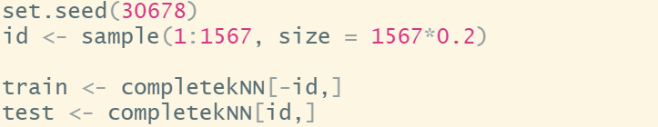
Step 5 Data imbalance
We use the kNN methods to processing data imputation with k = 5.
We divided data into train and test set by 0.2.

Slide 8
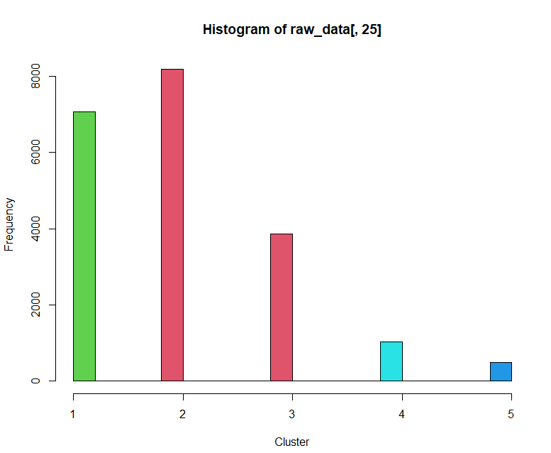
Step 3 Data imbalance
There exist imbalance in the data.
We decide to re-sampling the data to fix this problem.

Slide 9
Step 3 Data imbalance
Pesudo code
Label <- (class name of dependent variable)
Repeat
x <- ∅
x <- which (data == Label [i] )
If (length(x) > n ) then sample class without replacement.
ELSE then sample class with replacement.
END
We applied the hybrid resampling technique.
Moreover, based on several test iterations (1000 to 4000 , step = 500) found that n = 3000 has the best. performance.

Slide 10
PART MODEL FITTING
2

Slide 11
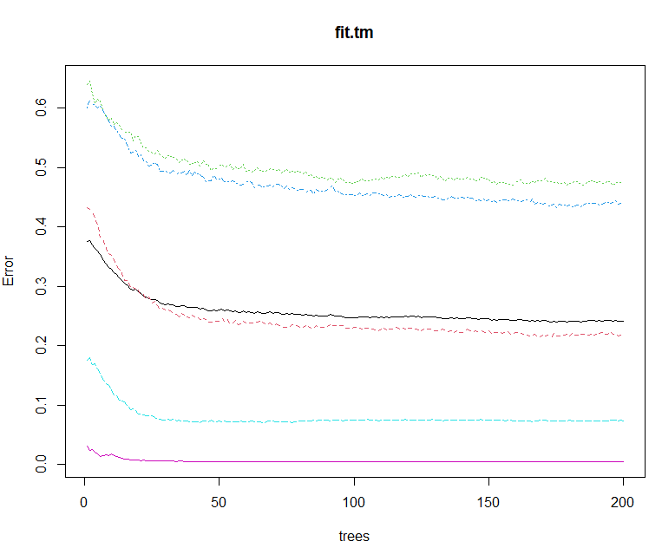
FITTING MODEL : Classification Random Forest
Based on the Fig. right-hand side. When ntree > 200 error are almost same so I decide use ntree = 200 to fit the model.

Slide 12
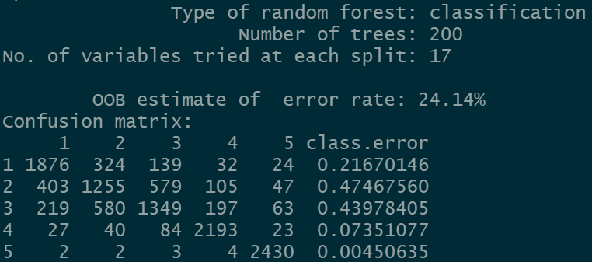
FITTING MODEL : Classification Random Forest
Confusion matrix shows that the Out-Of-Bagging estimate of error rate is 24.14%.

Slide 13

FITTING MODEL : Classification Random Forest
After combined with re-sampling, tuning hyperparameter, feature importance etc. And upload outcome several time. The best score I can get is 1.2405.

Slide 14
THANKS!

